Slide 1
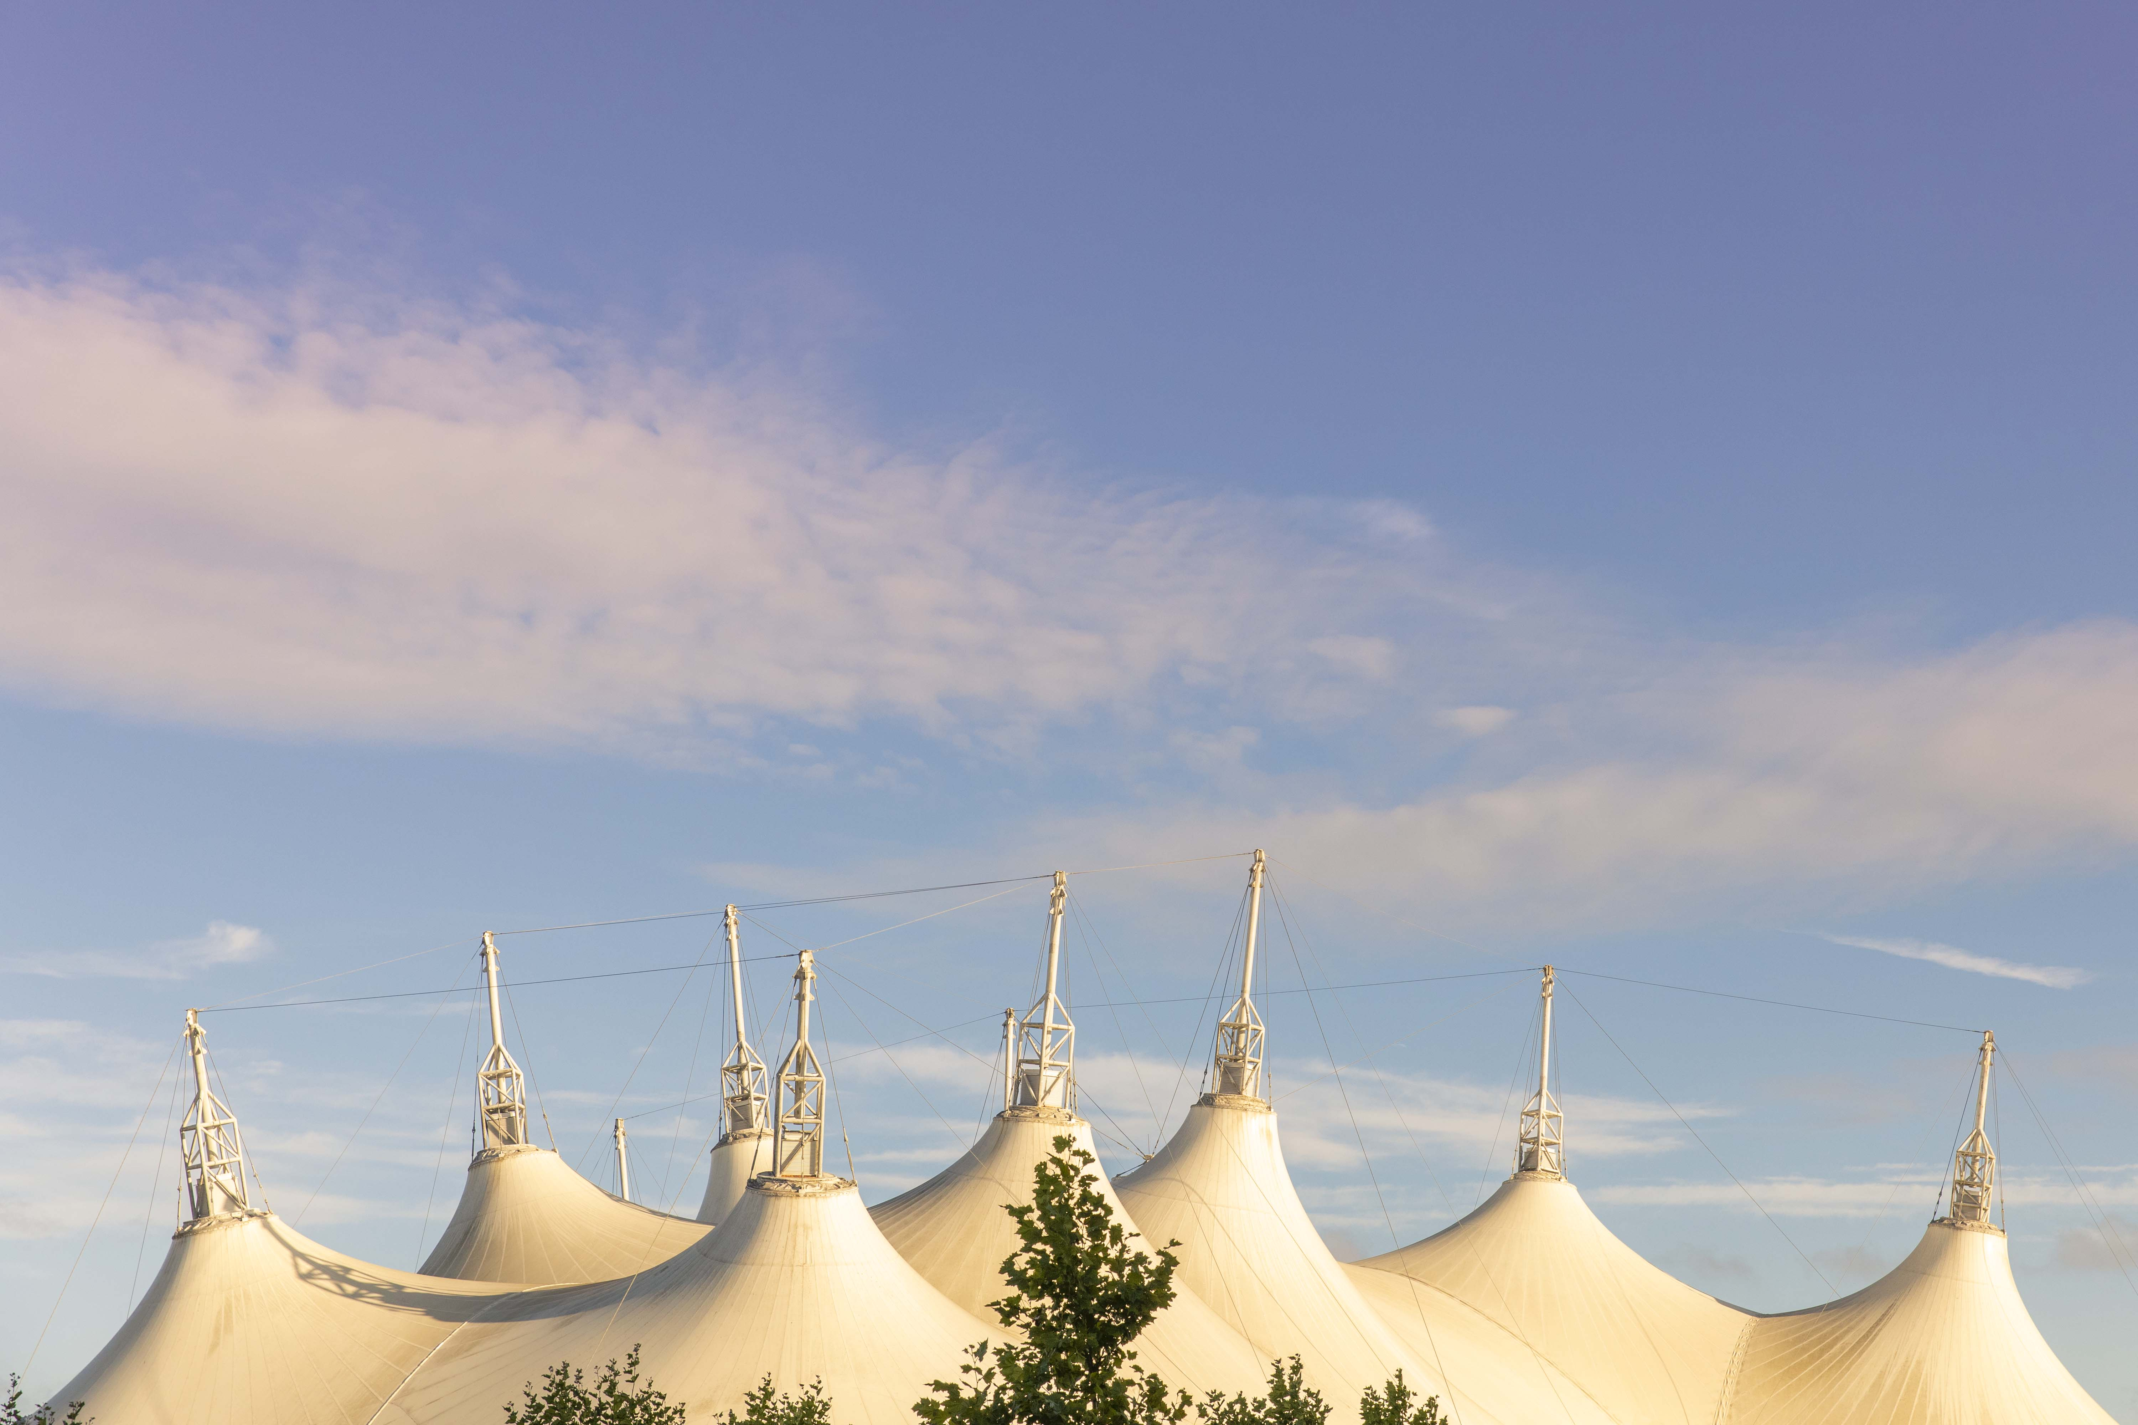
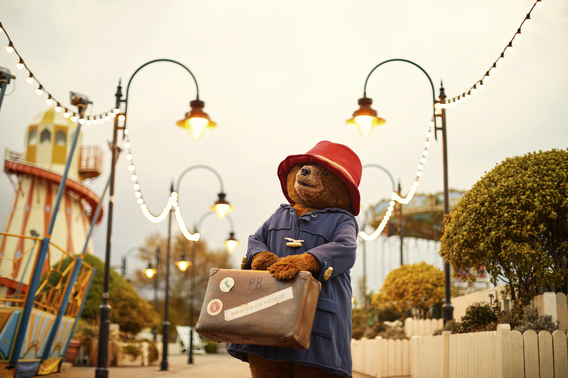
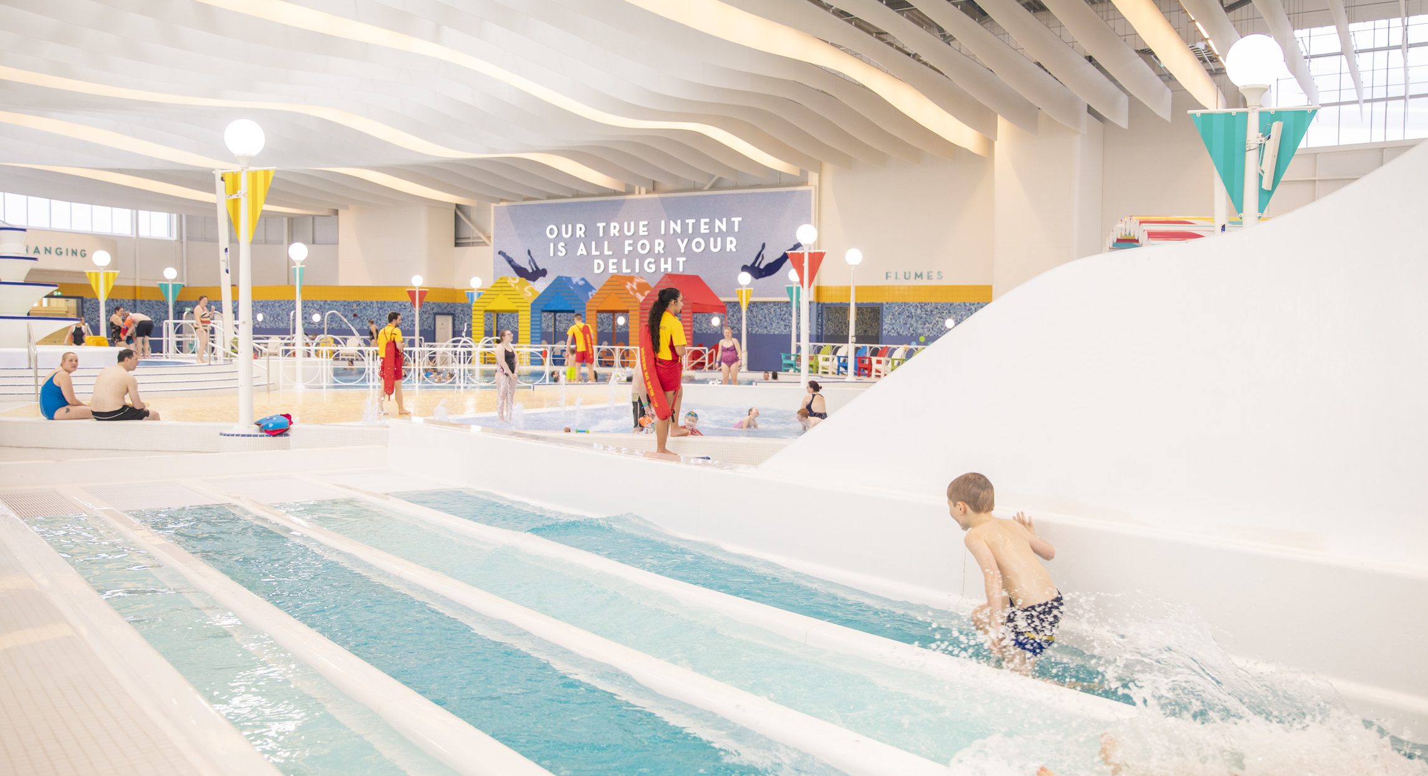
MONDAY 14TH OCTOBER 2019
LOCAL RESIDENTS
MEETING

Slide 2
PURPOSE
PPP
So that you all feel informed of what's been going on around resort and the actions we are taking to minimise the effects our operation has on our residents.
PROCESS
I'll take you through this short presentation to update you on our pool and the measures we have put in place to ensure we meet our residents needs and expectations. I'll then also provide you with an overview of what's been going on across resort these past few months and what you can expect to see over the coming months as 2019 draws to a close. As always we'll wrap up this evening up with an opportunity for you to all ask me any questions you have.
PAY OFF
So that you all feel informed of what's been going on resort and the actions we are taking to minimise the effects our operation has on our residents.

Slide 3
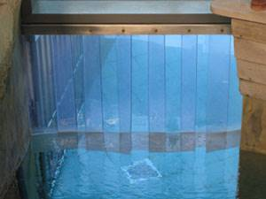
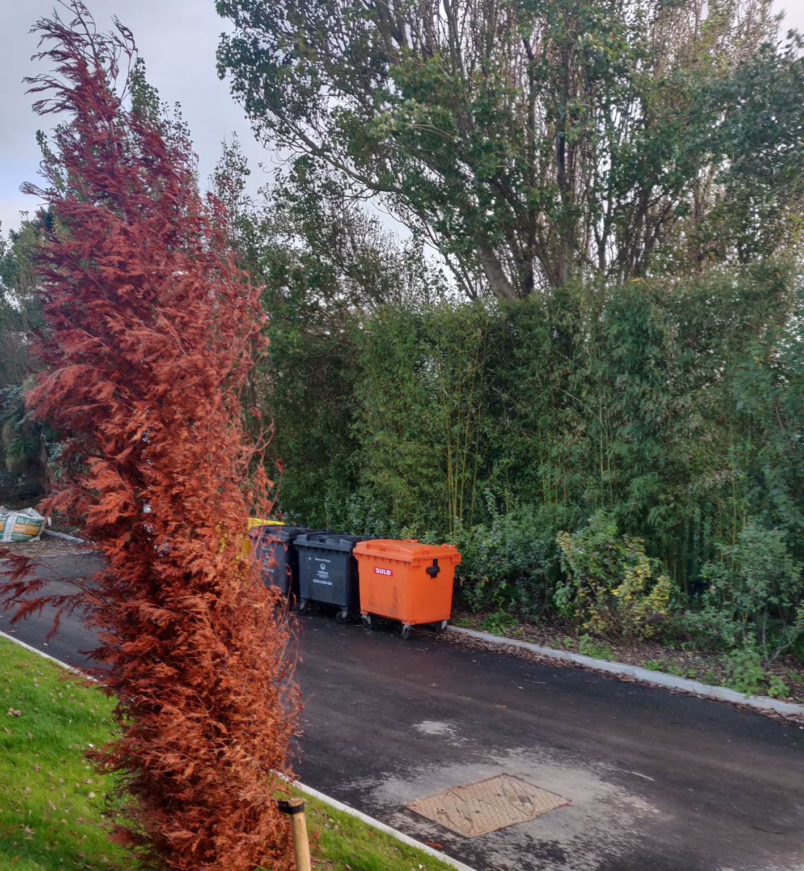
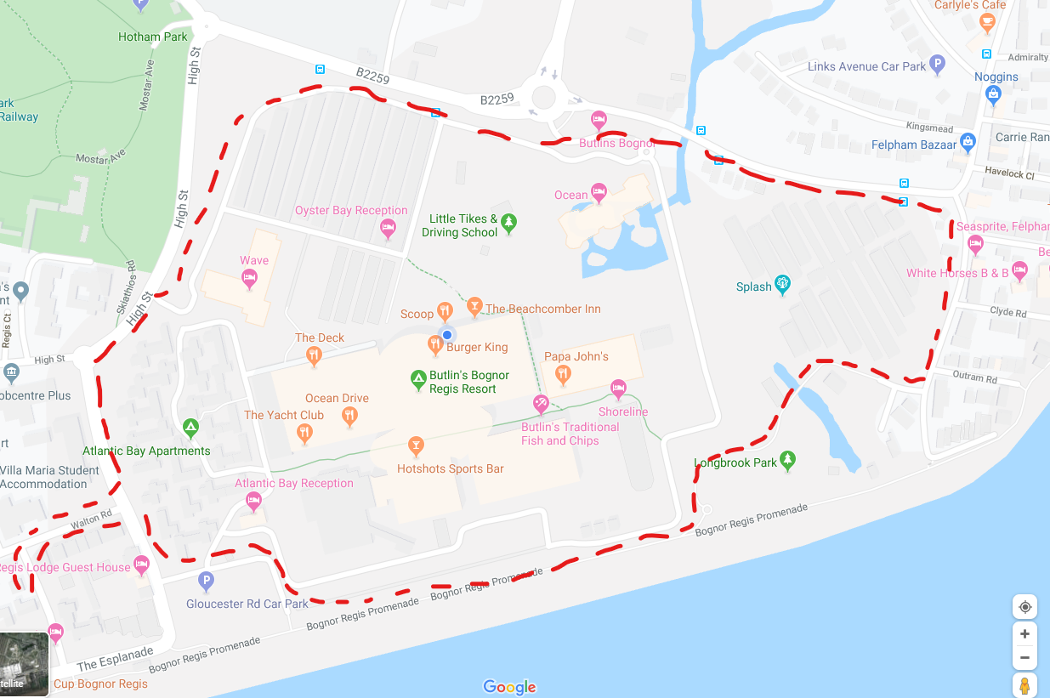
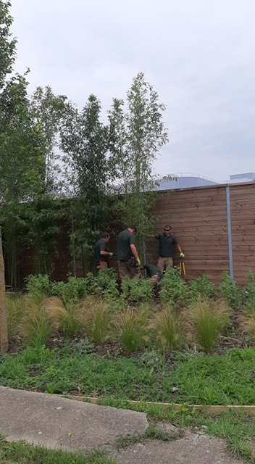
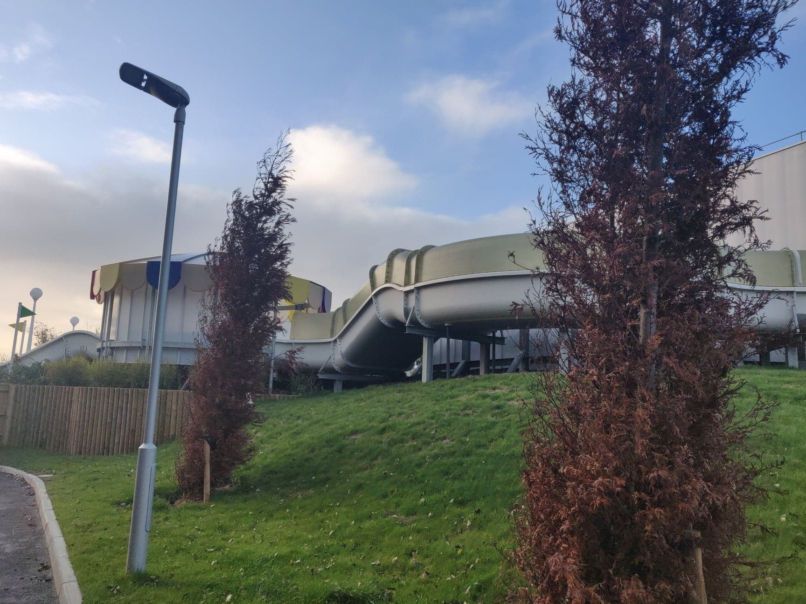
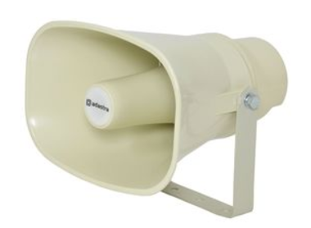
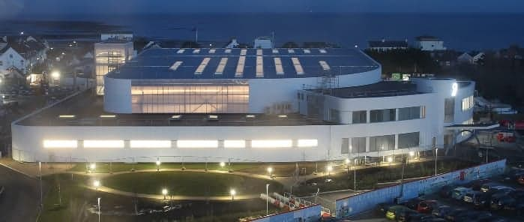
ISSUES RAISED AND ACTIONS TAKEN
POOL UPDATE
NOISE COMPLAINTS
ACTIONS
1- Bamboo Trees
Perimeter Walks
2- Roof over Rapids
3- Noise Monitoring
4- Tannoy vs Radio’s
5- Noise Curtain
6-Light Pollution

Slide 4
ESF PRIVATE EVENT
POOL UPDATE
ISSUES RAISED AND ACTIONS TAKEN
8th - 11th May 2020 & 15^{TH -} 18TH MAY 2020
ACTIONS
1- Amended Operating Times
2- Amended Age Groups

Slide 5
POOL UPDATE
OUTSTANDING ISSUES
CHP Units- silencers being installed on Mon 14th (Today!), Tuesday 15th and Wednesday 16th.
(Combined Heat and Power units)
This should eliminate the issues residents have been hearing with white noise…

Slide 6
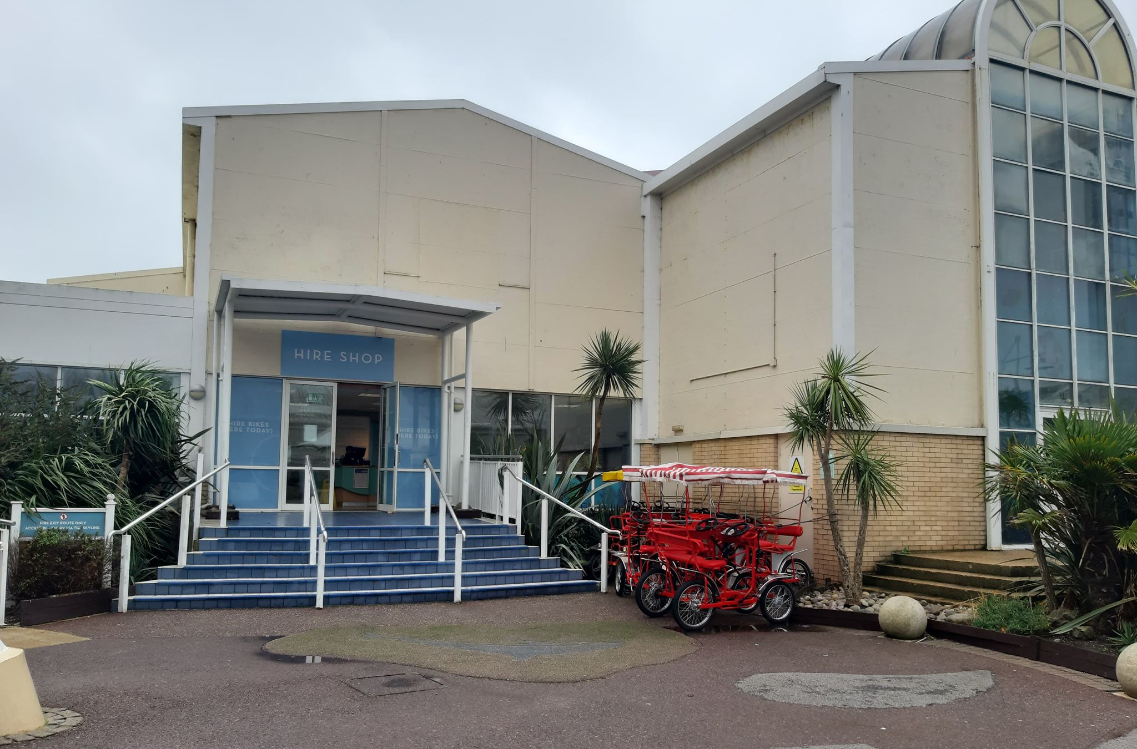
POOL UPDATE
WHAT’S HAPPENING WITH THE OLD POOL?

Slide 7
OUR SUCCESS STORIES
LONG TERM SUCCESS AND SUSTAINABILITY OF BUTLIN’S RESORT

Slide 8
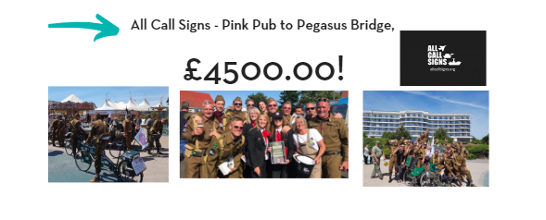
CHARITY SUPPORT

Slide 10
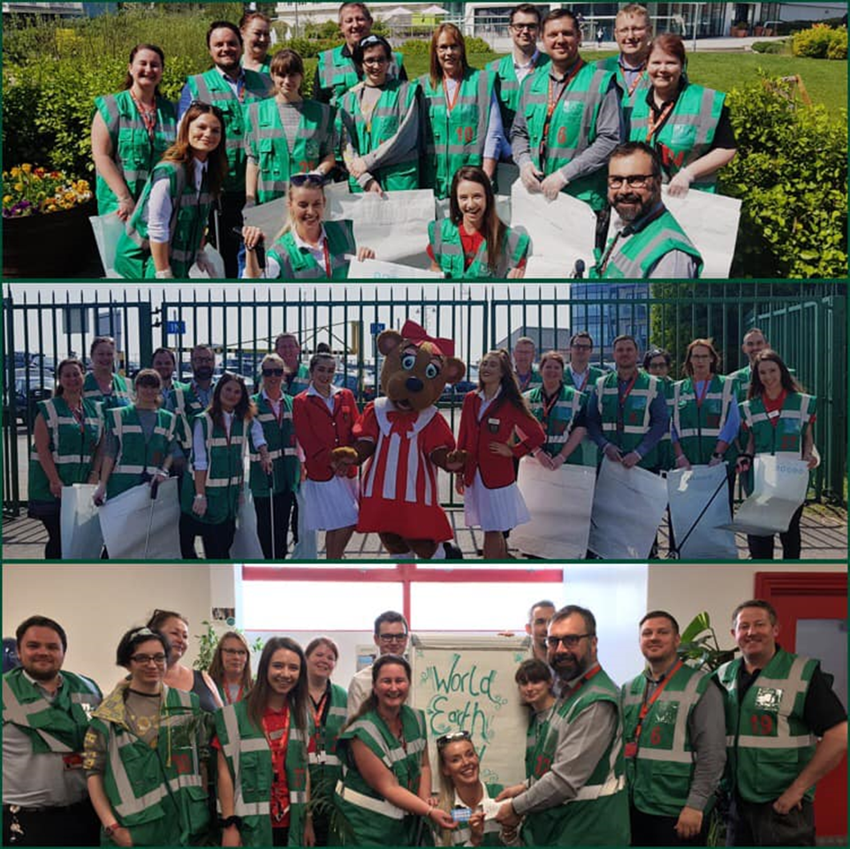
GREENTEAM
Water Fountains- 2020
Tip It Flip It Stack It – 10,000 cups recycled.
Coffee Beans Recycled and reused.
Hedgehog Homes
World Earth Day

Slide 11
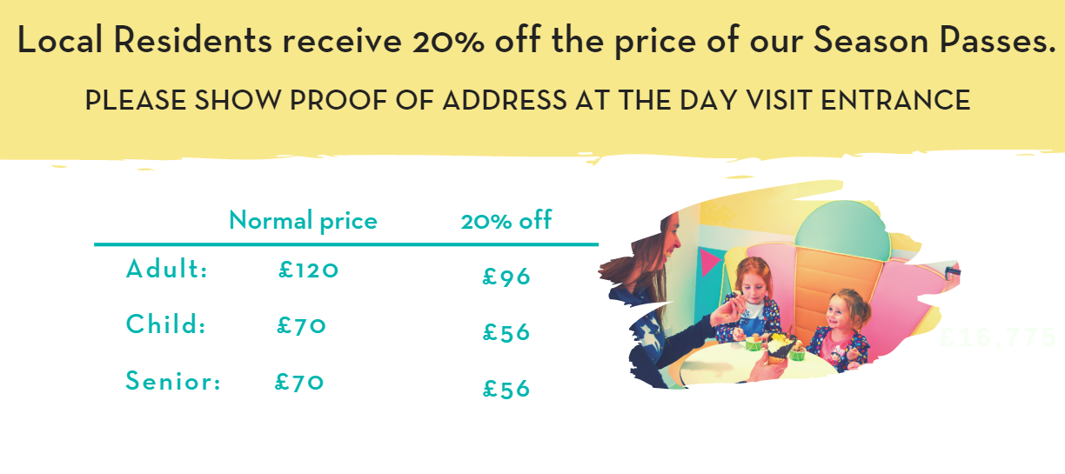
t
LOCAL RESIDENT’S OFFER
150 RESIDENTS HAVE PURCHSED ONE OF OUR SEASON PASSES.
WITH THE DISCOUNT APPLIED IT’S THE EQUIVALENT OF 4 VISITS OVER THE SUMMER

Slide 12
FIREWORKS
INVITE

Slide 13
Switchboard: 01243 820202
Resort Safety Control Room: 01243 810020
Main Gate: 01243 820202 ext. 5005
Jason Hutton (Operations Manager): 01243 8100074
Jason.Hutton@bourne-leisure.co.uk
Matt Lander (Resort Safety Head of Department): 01243 820202 ext. 5240,
Matt.Lander@bourne-leisure.co.uk
Day Visits (for Resident’s Pass and circus tickets enquiries): 0330 100 9732 (option 1)
BognorDayVisits@bourne-leisure.co.uk
IMPORTANT CONTACTS
Resort 24hr Phone Number:
01243 810020
Day Visits (for Resident’s Pass):
0330 100 9732 (option 1)
BognorDayVisits@bourne-leisure.co.uk

