Slide 1
Rampion 2 Offshore Wind Farm
Local Impact Report
17 January 2024

Slide 2
Project Overview
A Development Consent Order (DCO) application has been made for up to 90 offshore wind turbine generators (extending between 13km and 25km offshore), associated foundations, cables and substations (on and offshore);
Buried onshore cables would be in a single corridor approximately 38.8km in length from a landfall at Climping. A new onshore substation will be located at Oakendene (Horsham) that will connect to the existing substation at Bolney, Mid Sussex;
The maximum blade tip height above Lowest Astronomical Tide would be 285m for the smaller wind turbine generators and 325m for the larger wind turbine generators. The size and capacity would be determined post consent during detailed design; and
Access and construction of the project would commence in late 2025, with the project becoming operational in 2030.

Slide 3
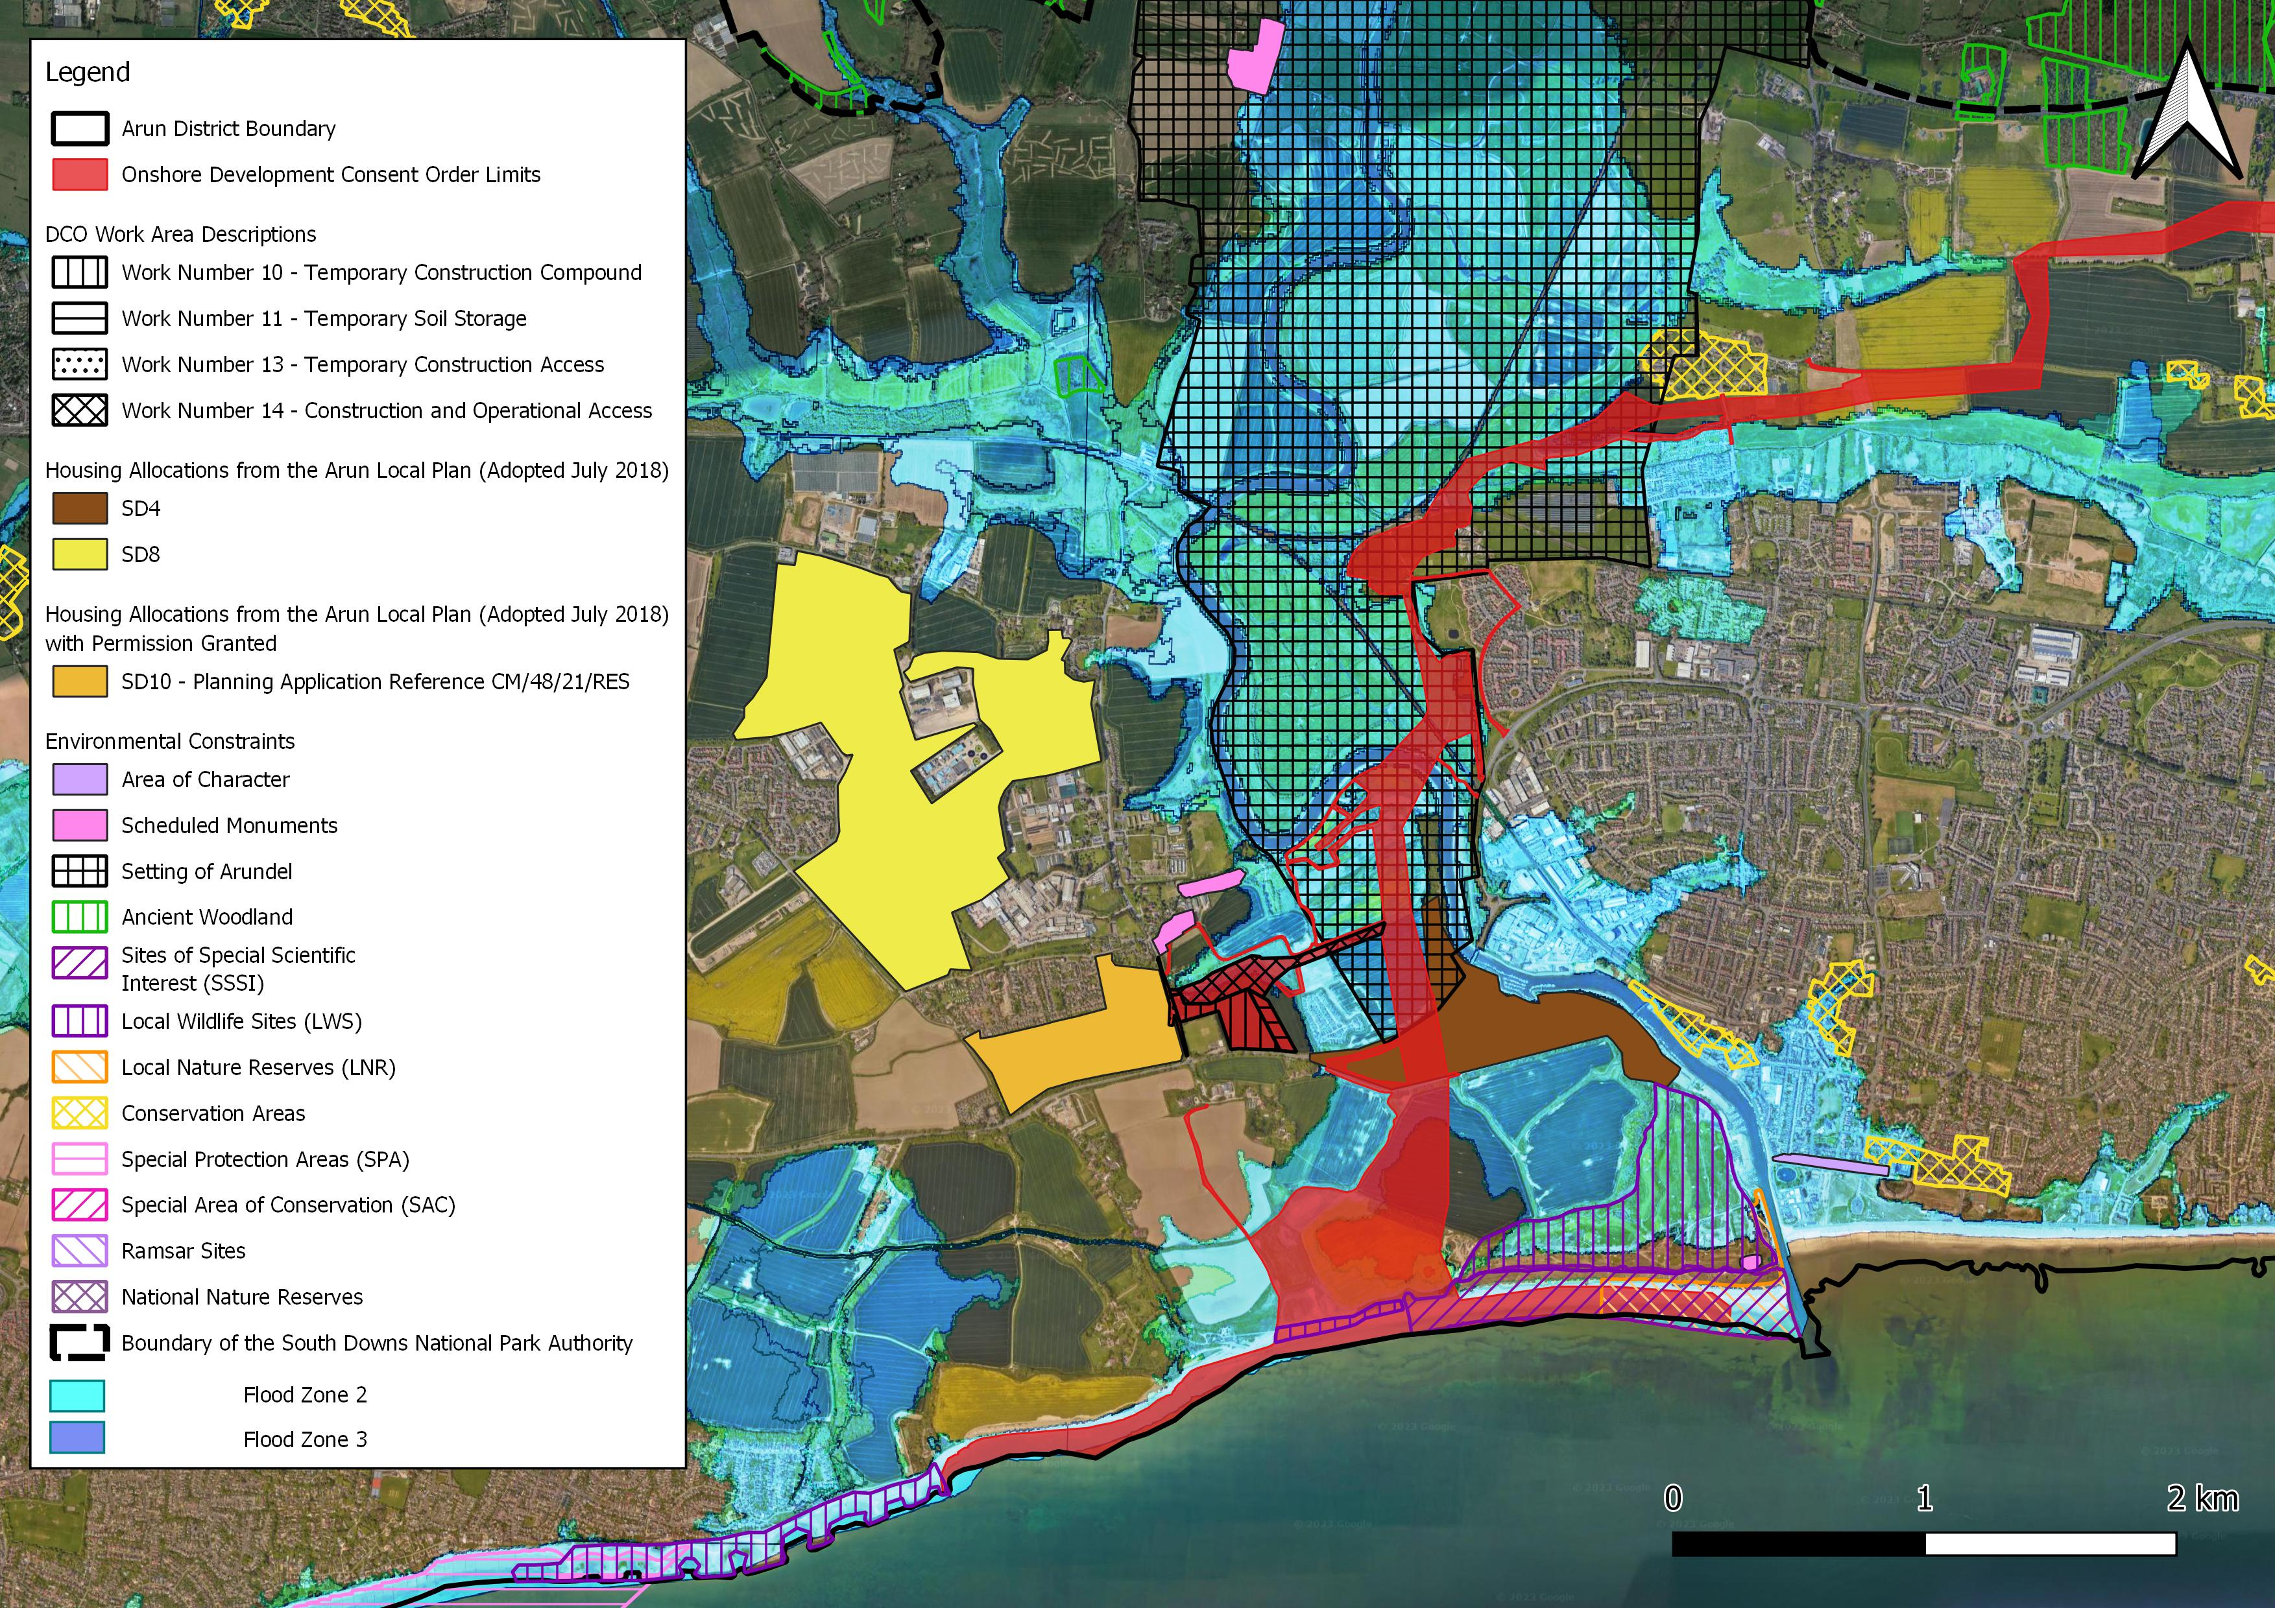

Slide 4
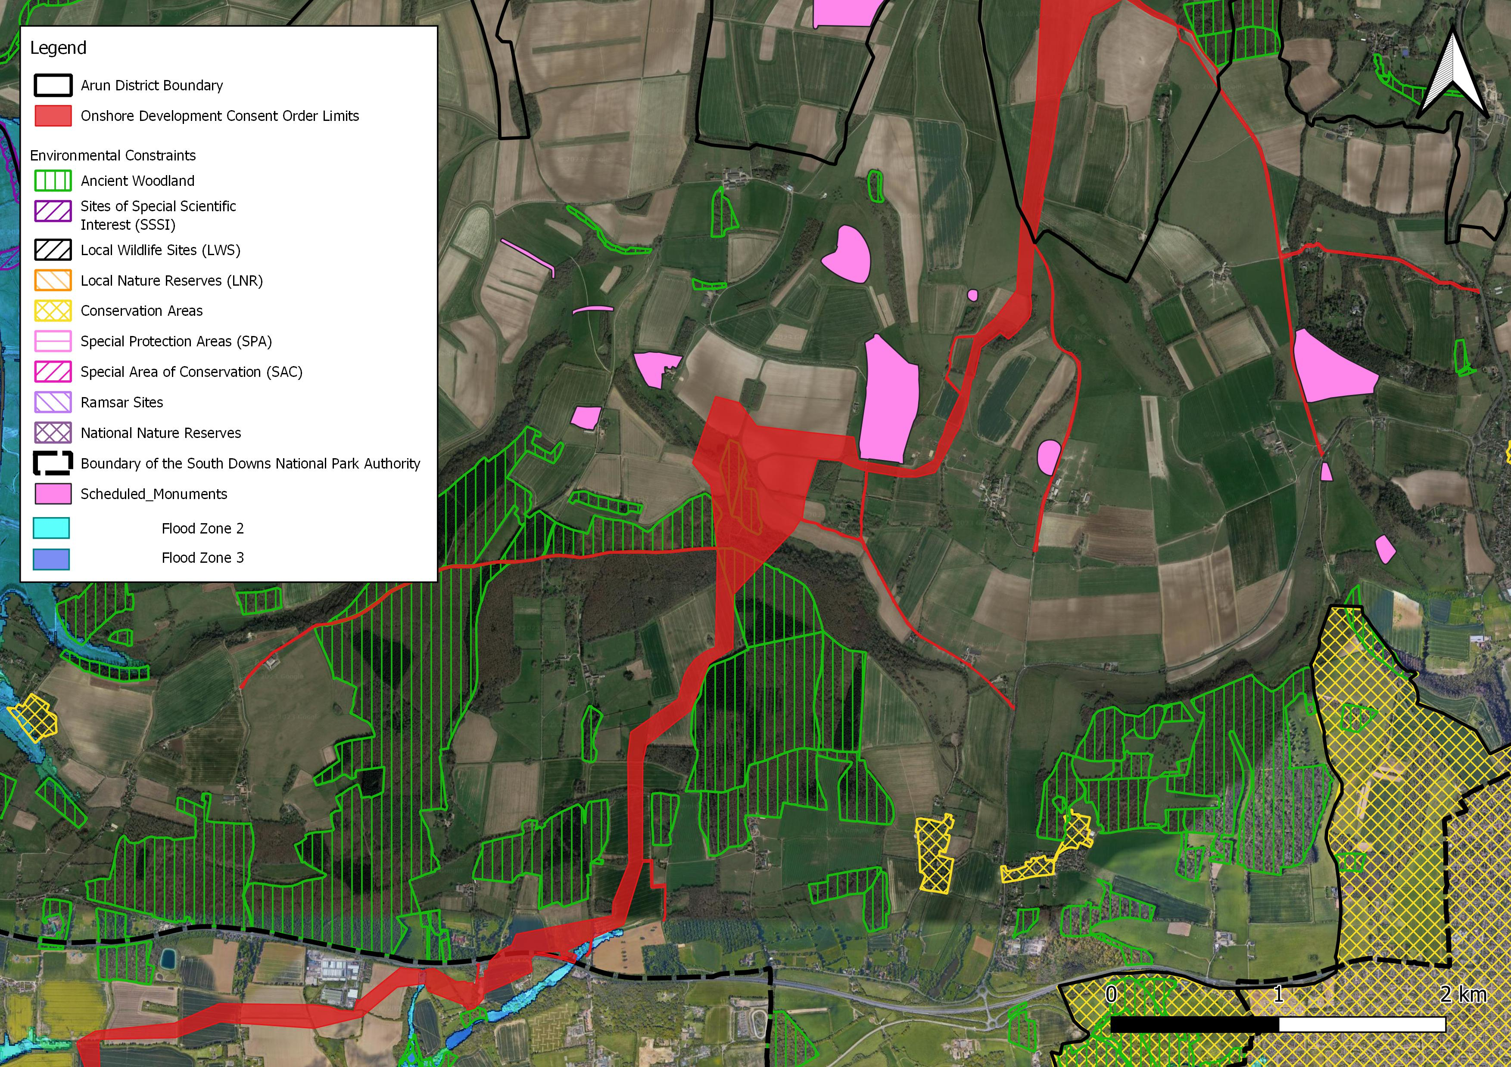

Slide 5
DCO Process Overview
The Planning Act 2008 establishes that consent is required for development that is, or forms part of, a Nationally Significant Infrastructure Project and therefore an application was made to the Secretary of State;
Following acceptance of the application in September 2023, ADC has submitted a Relevant Representation and an initial Principal Areas of Disagreement Statement to the Examining Authority. ADC has since been preparing the Local Impact Report;
The draft Examination timetable has been published by the Examining Authority which sets out a programme of written and oral submissions; and
After the Examination has been concluded, the Examining Authority will make a recommendation (expected November 2024) to the Secretary of State, who will make the decision on whether or not to make a DCO authorising the project.

Slide 6
Purpose and Scope of Local Impact Report
Defined by the Planning Act as ‘a report in writing giving details of the likely impact of the proposed development on the authority’s area (or any part of that area)’ ;
The content is a matter for the local authority concerned as long as it falls within this statutory definition. The local authority is not required to carry out its own consultation with the community;
Should consist of a statement of positive, neutral and negative local impacts and should be used by the local authority to provide evidence on local issues that can be robustly reported to the Examining Authority;
The Local Impact Report builds upon the Relevant Representation and Principal Areas of Disagreement Statement. The Local Impact Report focuses on subject and geographical areas which ADC has primary planning responsibility; and
During the Examination, the Examining Authority will carry out a balancing exercise of impacts, including the local impacts specifically reported in the Local Impact Report.

Slide 7
Preparation of Local Impact Report
Undertaken a review of environmental sensitivities and socio-economic considerations within Arun;
Undertaken a review of the documentation, including the Environmental Statement, submitted by the Applicant to the Examining Authority;
Undertaken a review of Relevant Representations submitted by Interested Parties to the Examining Authority;
Informed by extensive discussions with Officers at ADC, including on built heritage, landscape, biodiversity, noise, economics and tourism;
Meetings have also been held with West Sussex County Council, Horsham District Council and South Downs National Park Authority; and
Draft Local Impact Report was shared with Town/Parish Councils and also discussed at a meeting with the Senior Management Team at ADC in December 2023;

Slide 8
Summary of the Local Impact Report
Identifies that the likely effects at local level are predominately neutral or negative, although acknowledges the benefits of the renewable energy in contributing to the national target of net zero.
Main Topic of Local Impact Report | Positive Impact | Neutral Impact | Negative Impact
Skills and employment
Tourism and tourism assets
Community disruption
Strategic housing allocation
Landscape and visual
Seascape
Ecology
Noise
Vibration
Historic environment
Renewable energy / climate change

Slide 9
Identifies further assessment is needed in some areas so that the likely effects can be fully understood and can be appropriately mitigated/compensated for at local level, notably in relation to socio-economics, biodiversity, landscape and noise;
Seeks firmer commitments for mitigation/compensation to delivering social, economic and environmental benefits that are specific to Arun, including:
Biodiversity – biodiversity net gain within Arun and contribution to Sussex Kelp Recovery Project ;
Landscape – maximise opportunities for advanced planting and reinstatement of vegetation/habitats within the first planting season;
Socio-economics – securing a community benefits package, linking the Outline Skills and Employment Strategy to apprenticeships/local education institutes and measures to support SMEs;
Noise and vibration – noise and vibration monitoring;
Made some recommendations to the requirements of the draft DCO so that ADC are consulted regarding the approval of documents prior to construction works.

Slide 10
Key Dates and Deliverables
Item | Date/Progress | Examining Authority Deadline
Adequacy of Consultation | Submitted | 21 August 2023
Relevant Representation | Submitted | 6 November 2023
Initial Principal Areas of Disagreement Statement | Submitted | 6 November 2023
Local Impact Report - ADC Planning Committee to resolve recommendations within the Committee Report | 17 January 2024 | NA
Preliminary Meeting | NA | 6 February 2024
Local Impact Report | In progress | 20 February 2024
Issue Specific Hearings | NA | 7 to 9 February 2024, with further Hearings in May/July
Written Representation - this will be a summary of key issues of the Relevant Representation, Principal Areas of Disagreement Statement and Local Impact Report, with a focus on key areas of concern. | In progress | 29 February 2024
Final Statement of Common Ground (led by the Applicant) | NA | 9 July 2024
Final Principal Areas of Disagreement Statement | NA | 1 August 2024

